Slide 1
Hackathon for Good
Indo Data Week
Team Appendly M.Rajasekar,
S.Sai Adarsh,
S.Sanjay
Shakileash Chinraj

Slide 2
Theme, Problem Statement and Github Link
> Theme : Climate Resilient Food Security
> Problem Addressed: Lack of importance given to Food Security in the decision of crop selection by Farmers and lack of a regulatory body to standardize Food Security.
> Github Link : https://github.com/Shakileash5/Food_security

Slide 3
Vital Problem - Rural/Tribal Areas
India currently has the largest number of undernourished people in the world i.e. 212 million. The total number of undernourished people was 172.4 million in 1990–92 which rose to 237.7 million in 2005–07 i.e. nearly 38% increase in undernourished people.
TL;DR: India is largely undernourished despite having enough supply to feed the entire population.
Reason: Lack of Agricultural Productivity and lack importance given to crop diversity in Rural and Tribal Areas.
Notes:
“It has been projected that availability of water for agriculture use in India may be reduced by 21 percent by 2020, resulting in drop of yields, especially rice, leading to price rise and threat to food security of the poor.”

Slide 4
Vital Problem - Crop Diversity
Another area which needs to be explored is ‘crop diversification’. Higher profitability and the stability in production highlight the importance of crop diversification, e.g. legumes alternative with rice and wheat. Growing of non-cereal crops such as oilseeds, fruits and vegetables etc need to be encouraged.
TL;DR: Greed for high profit among individual farmers have took a toll on the crop diversity of a region which affects the food security.
Reason: Lack of a Regulatory body for the Government

Slide 5
Our Enterprise Solution
“A Prediction Model that which will analyse the various factors associated with the Food security of the region and would suggest remedial measure for the same.”
“A Data Driven Algorithm that will suggest the best suiting crop for the given area based on vital metrics on Social Equity, Environmental Health and Economic Vitality coupled with Crop Diversity of the Region to the Farmers as well as the Regulatory Body.”

Slide 6







Model Used - Our Approach
[POST]
[POST]
DJANGO FRAMEWORK
THERMAL FACIAL IMAGE GENERATION
USER
RASPBERRY PI MODEL
CONVOLUTIONAL NEURAL NETWORK MODEL BUILT BY TENSORFLOW
CLASSIFICATION
WEB APPLICATION
Notes:
To Do

Slide 7



Model Used - Flow of the solution
STEP 1
STEP 2
The input is analysed with various parameters that affect the crop diversity of the region and the results are produced
STEP 3
Proposal of the crop cultivation plan is given as an input
The cultivator is suggested with best practices that ensures both profit and crop diversity

Slide 8
Algorithms Used (Stats for Nerds)
Image Classification Algorithm Used : Convolutional Neural Network
Architecture Used : Standard Architecture
Activation Function used : Sigmoid Function
Type of Classification : Binary Classification (For Now, Could also be upgraded into a Multi-way Classification Model).
Batch Size : 16
Number of Layers : 6
Labelling of the Dataset : Stressed and Not Stressed.
Notes:
To Do

Slide 9
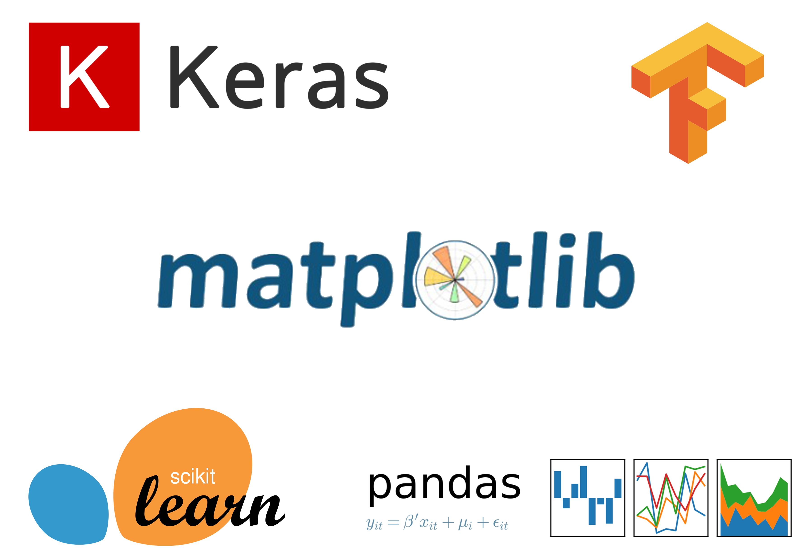
Tech Stack Used - Our Toolkit
Notes:
To Do

Slide 10
Who is this Solution For?
The entire essence of the solution is to regulate the individual farmers unto making rightful crop choices to ensure profitability and crop diversity at the same time and that in turn can be achieved only by governing entities like the Government of a state or the Agricultural Ministry per se. And therefore, the solution is intended for the Public Bodies.

Slide 11
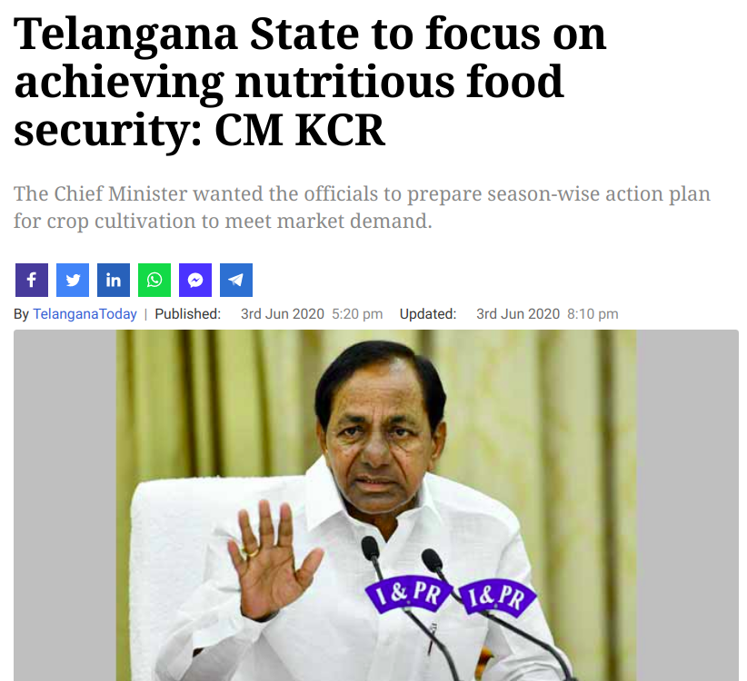
Business Impact - Visible Potential
SOURCE

Slide 12
Sources and References
Telangana Open Data Portal
Ambee Data
Measures to ensure food security
A data-driven approach improves food insecurity crisis prediction, World Development
Food Security Index
Notes:
https://data.telangana.gov.in/search/type/dataset
https://docs.ambeedata.com/#soil-intro
https://ruralmarketing.in/stories/10-measures-to-ensure-national-food-security/
E.C. Lentz, H. Michelson, K. Baylis, Y. Zhou, A data-driven approach improves food insecurity crisis prediction, World Development, Volume 122, 2019, Pages 399–409, ISSN 0305–750X.
https://foodsecurityindex.eiu.com/Country

